Slide 1
Week 2
Final Sounds

Slide 2
Warm Up Discussion
If you could only have one, would you rather have your mobile phone or computer?
Would you rather live 100 years in the past without any technology, or 100 years in the future with incredibly high technology?

Slide 3
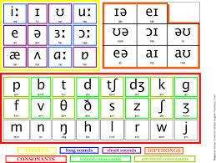
Review
What is the phonemic alphabet?
The alphabet of sounds
Why is it important to learn?
Because English is not a phonemic language.
The way that words are spelled if often different from how they are pronounced

Slide 4
Review
What’s the difference between a voiced and an unvoiced sound?
Voiced Sounds: Use the vocal cords
Examples, /z/, /g/, /v/, all vowels
Unvoiced Sounds: Do not use the vocal cords
Examples: /s/, /k/, /f/
/f/ and /v/ practice: http://www.heathermeloche.com/AP%20Tongue%20Twisters.htm

Slide 5
Voiced and Unvoiced “th” (θ and ð)
To make the sounds correctly, you must stick your tongue out. Otherwise;
The pronunciation of the word will be incorrect
There is a chance that the listener will mistake the word you said for something else
http://www.pronuncian.com/Lessons/Default.aspx?Lesson=200
http://www.uiowa.edu/~acadtech/phonetics/english/frameset.html

Slide 6
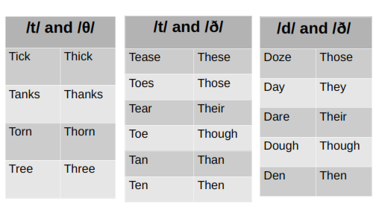
Word Confusion
If your tongue is not on your teeth, the listener will hear the wrong word

Slide 7
Sound Deletion
Not pronouncing certain sounds in words
Most commonly in the middle or final position
Middle
Facebook
Tuesday, Wednesday, Thursday
Children
Final
Like
Rice
Because

Slide 8
Tips for Enunciating Final Sounds
Actively listen to the pronunciation of final sounds by native speakers and observe your own pronunciation. Do they sound the same?
Over pronounce the final sound to make it easier for you to remember and for others to hear (moviessss, becausssssse, likesssss, etc.)
As you learn new words, be aware of the final sounds and consciously over pronounce the ending
Eventually you will master pronouncing the final sound and the length and emphasis will reduce naturally (movies, because, likes, etc.)

Slide 9
Count the Syllables
How many syllables do each of these words have?
Want → Wants Listen → Listened
Table → Tables Book → Booked
Place → Places Want → Wanted

Slide 10
Adding Syllables
There are times when we must add an extra syllable to the base form of words when speaking
Important
If the pronunciation is incorrect, your listener might misunderstand or hear an unintended grammar mistake

Slide 11
Pronunciation of Final -s
Words ending in “s” are most commonly;
Present simple tense verbs (like → likes)
Plural nouns (tree → trees)
Possessives (Ashley → Ashley's)
Pronunciation Rule: Add an extra syllable to the base form of the word if it ends with an /s/, /z/, /ʃ/, /ʒ/, /tʃ/, /dʒ/ sound
The extra syllable is pronounced /Iz/

Slide 12
Examples
/s/ : Place → pla-ces (noun/verb)
/z/ : Cause → cau-ses (noun/verb)
/ʃ/ : Wash → wa-shes (verb)
/ʒ/ : Ga-rage → ga-ra-ges (noun)
/tʃ/ : Teach → tea-ches (verb)
/dʒ/ : Cha-llenge → cha-llen-ges (noun/verb)

Slide 13
Pronunciation of Final -ed
Words ending in -ed are most commonly
Simple past tense verbs (learn → learned)
Adjectives (skilled, light hearted, open minded)
Pronunciation Rule: When adding the -ed ending to words, add an extra syllable if the base form of the word ends in a /d/ or /t/
The added syllable is pronounced /Id/

Slide 14
Examples
/d/
Need → nee-ded
De-cide → de-ci-ded
/t/
Want → wan-ted
Col-lect → col-lec-ted

Slide 15
Speaking Topics
What was your dream job as a child?
Why did you decide to choose a career in IT?
What’s your favorite memory from university?
What are some things that make for a perfect working environment?

